Slide 1
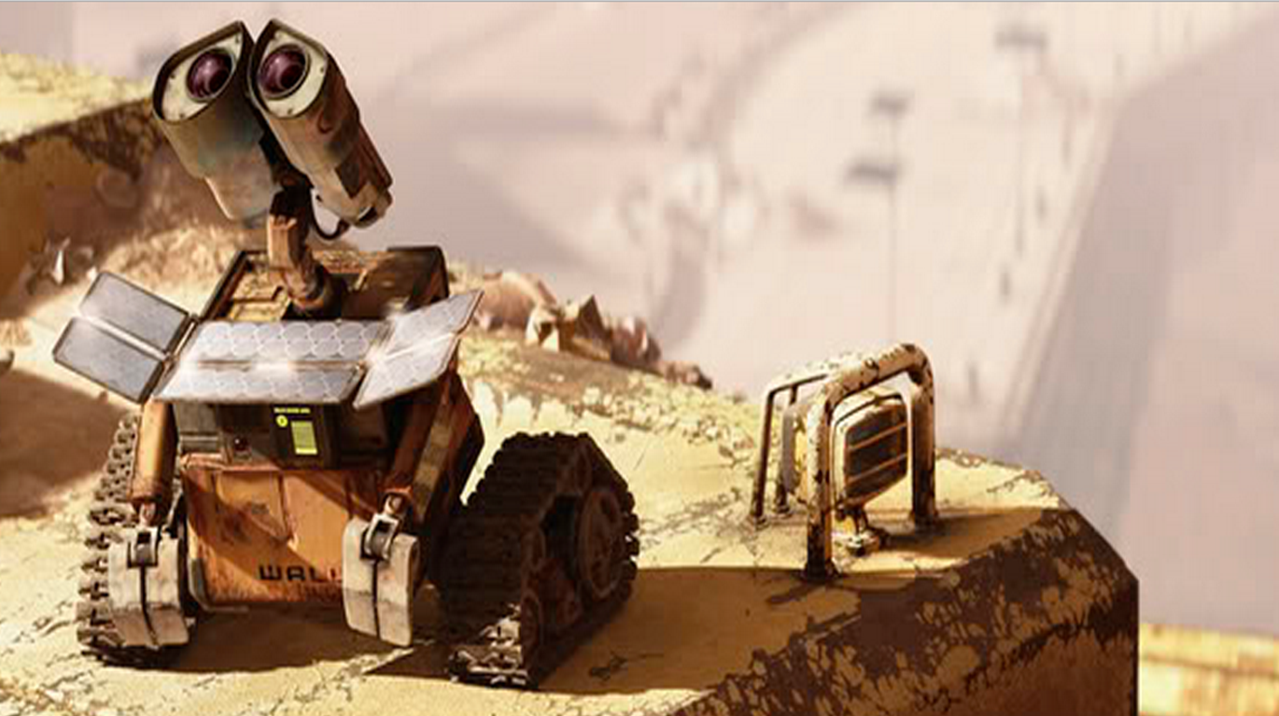

Mobile Solar Power Station
By: Sneaky Rain: Jordan Rainey, Jordan Ziegler, Daniel Lombardo, Rocky DeLyon, Joshua Hanson

